Slide 1
Introductory Atmospheric Chemistry
January 17, 2011
Atmospheric Chemistry Div^{n}
NESL/NCAR

Slide 2
Outline
Who are we, what do we do?
Why do we do it
  It’s important
  It’s fun
Why is it important?
Summary of the course
Basic atmospheric structure and circulation
Properties of the atmospheric gas/liquid phases

Slide 3
What is NCAR?
Part of the National Science Foundation
Both a laboratory and a facility
Support the University community
Improve research opportunities through collaboration
Study composition, meteorology, climate
Both “pure” and applied research

Slide 4
NCAR Facilities
Supercomputing
  Used for climate simulations
  Also global air quality studies
Aircraft Facility
  C130
  Gulfstream V (HIAPER)
Satellite measurements of global concs.

Slide 5
Atmospheric Chemistry Division
Approx. 100 people
Chemists, Physicists, Biologists
Lab, field and modeling activities
Much of field equipment developed at NCAR
Requirements: high sensitivity (for low concentrations) high frequency measurements (esp. for aircraft use)

Slide 6
Field Missions
Recent Missions include:
Mexico City (MIRAGE/MILAGRO)
Houston (Texas Air Quality study)
CELTIC (forested area near Duke, NC)
Amazonia (LBA, AMAZE)
Arctic (Airborne + ground)
Antarctic (South Pole station)

Slide 7
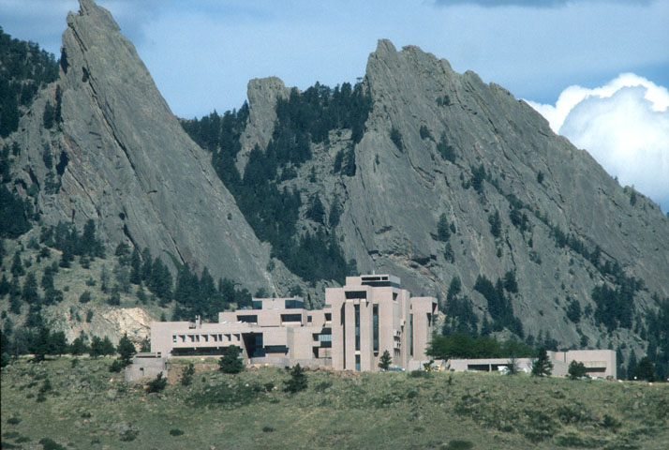

Slide 8
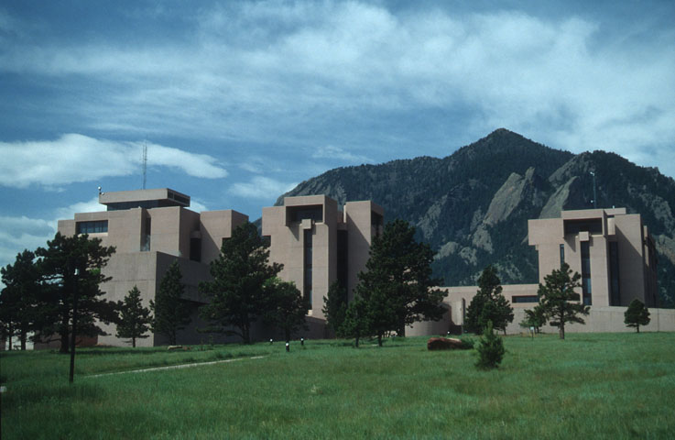

Slide 9
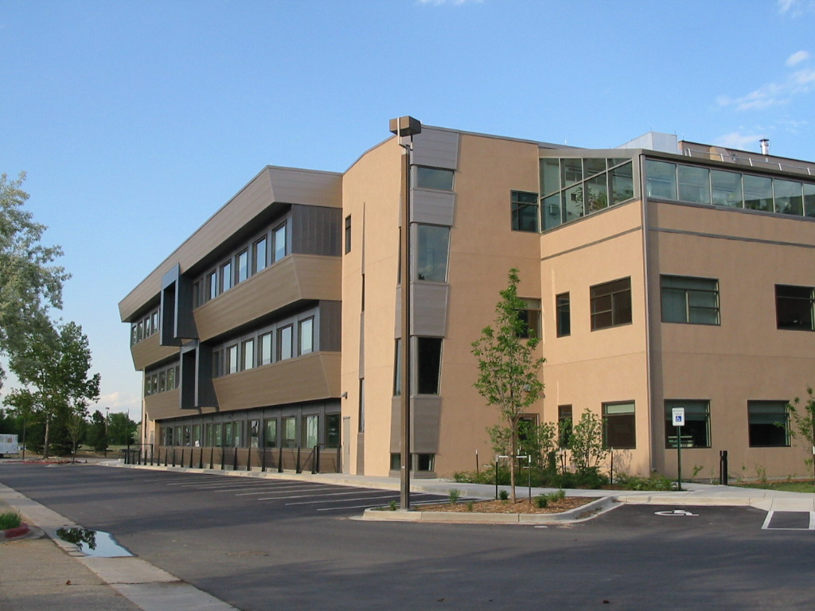

Slide 10
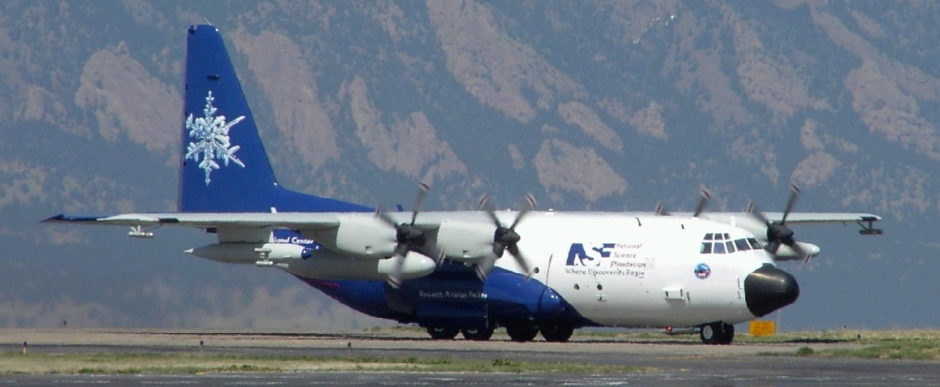

Slide 11
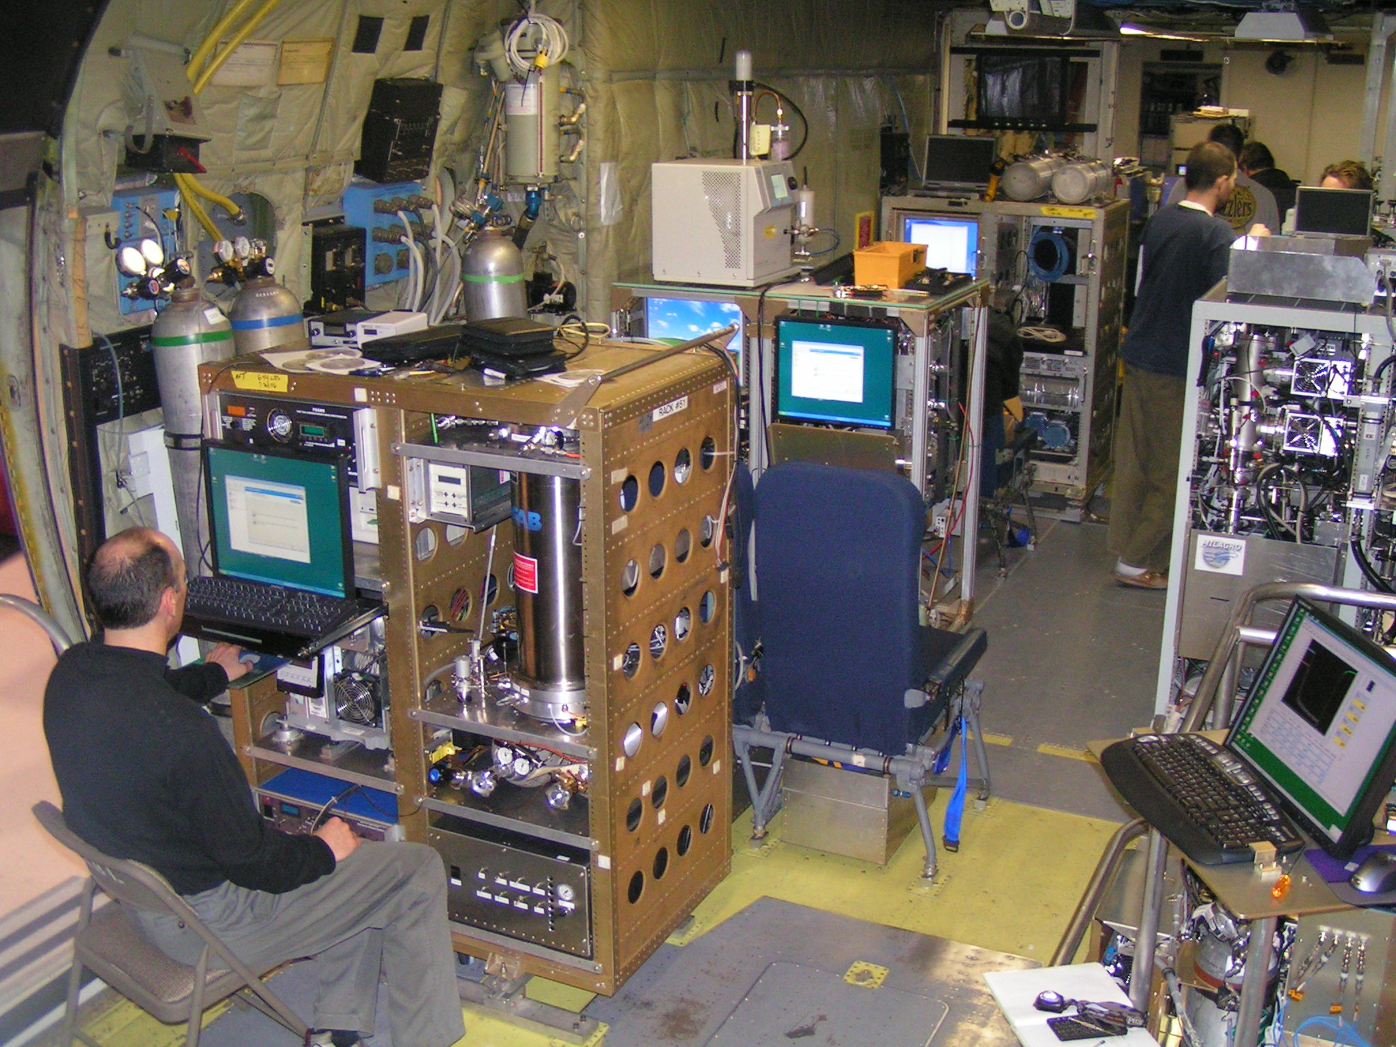

Slide 12
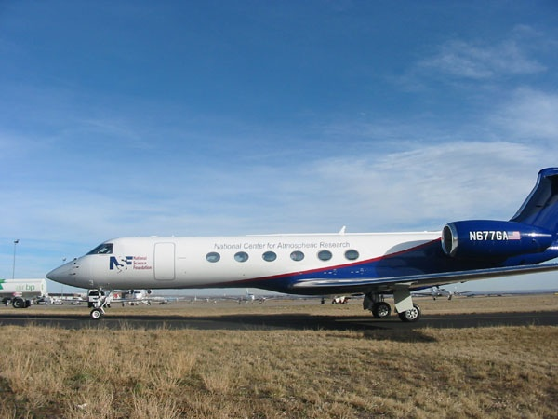

Slide 13
Relevance of Atmospheric Chemistry
Closely tied to air quality issues
Goes back hundreds of years (or more!)
Often linked to products of combustion
Now not just a local, but a regional, if not global phenomenon

Slide 14
“Smoke + Fog = ?”
Smoke in cities linked to health
Large scale mortalities noted in mid-20th C.
  Meuse (Belgium) in 1930 – 63 deaths
  Donora (PA) in 1948 – 20 deaths
  London (UK) 1952 – 4000 deaths
  Led to Clean Air Legislation
  SO₂ from combustion implicated
  Cold, foggy conditions

Slide 15
“Sunlight + cars = ?”
1950s in Los Angeles, severe air pollution
Formation of haze
Oxidizing atmosphere – eye irritation, crop damage
This occurred under dry, sunny conditions (in contrast to London events)
Presence of elevated ozone

Slide 16
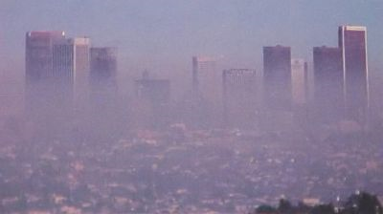
Photochemical smog formation
Now known to involve
  Organic compounds (VOC)
  Nitrogen compounds (NO₂)
  Sunlight
  Formation of ozone and other oxidants (PAN)

Slide 17
Acid Rain Formation
This phenomenon came to attention in the 1970s
Rainfall was becoming more acidic
Presence of H₂SO₄ (related to SO₂ from coal combustion) and HNO₃ (from NO₂)
Associated with forest decline
Importance of export of pollution!

Slide 18
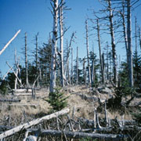
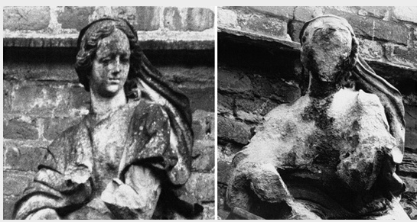
Effects of Acid Rain

Slide 19
Regional Transport of Pollution
Now recognized that one region affects another
Power plants in midwest → East coast
Pollution from CA → Rocky Mountains
Pollution from Asia → N. America
What is “true” background?
How does this affect legislation?

Slide 20
Global Atmospheric Chemistry
Chemistry is a part of the Whole-Earth climate system
Chemistry can affect climate
  Formation of aerosols, clouds
Climate can affect chemistry
  Emissions
Need to consider system as a whole

Slide 21
Course Outline
“Fundamentals” (online classes)
Lecture 1 (today) – Geoff Tyndall
  Fundamentals, history, how the atmosphere works
Lecture 2 (Jan 25) – Alex Guenther and Christine Wiedinmyer
  Emissions (including biogenics, anthropogenic, biomass burning)
Lecture 3 (Feb 1) – John Orlando
  Kinetics and Atmospheric Chemistry
  (to be given in Greensboro)

Slide 22
Course Outline (2)
Lecture 4 (Feb 8) – Sasha Madronich
  Photochemistry of atmospheric species
Lecture 5 (Feb 15) – Mary Barth
  Clouds, reactions in solutions
Lecture 6 (Feb 15) – Steve Massie
  Aerosols

Slide 23
Course Outline (3)
“Applications” (in Boulder)
Week of March 7 – 11
Lectures in morning, hands-on in afternoon
Nitrogen compounds (Frank Flocke)
Organic compounds (John Orlando and Geoff Tyndall)
Aerosol measurements (Jim Smith and Steve Massie)
Tropospheric Ozone (Sasha Madronich and Gabi Pfister)

Slide 24
Course Outline (4)
“Applications” (ctd)
Atmospheric Chemistry and Climate (Jean-Francois Lamarque)
Hands on:
Field Measurements techniques
  Frank Flocke, Eric Apel, Jim Smith
Remote Sensing
  Steve Massie
Atmospheric Modeling
  Louisa Emmons

Slide 25
Time to meet you!

Slide 26
Regions of the Atmosphere
Atmosphere naturally divided into regions based on temperature profile
Different chemical regimes, too

Slide 27
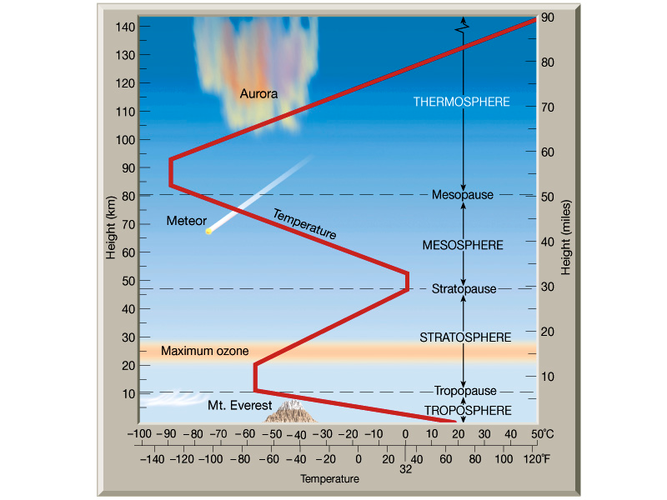
From Lutgens and Tarbuck, 2001

Slide 28
Structure of the Atmosphere
Troposphere (contains 90% of atmosphere)
Heated at surface by ground (caused by solar radiation)
Temperature falls with altitude
Troposphere is often turbulent
  Weather patterns
  Vertical mixing
  Chemicals mix over timescales days - weeks

Slide 29
Atmospheric Circulation
Circulation patterns are a result of energy from sun
Heating maximum at the Equator/Tropics
Air rises convectively in Tropics
Moves poleward, then descends
Sets up “Hadley Cells”
Air returns to Equator: Coriolis force moves it to west “Trade Winds”

Slide 30
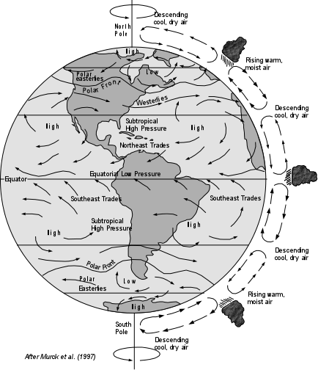

Slide 31
Importance of Tropics
Tropics are very active chemically
Moist, hot region, with plenty of sunlight
Also convection lifts chemicals here
“Tropical Pipe” main way to get chemicals from ground level to upper troposphere

Slide 32
The Tropopause
The coldest part of the troposphere is the tropopause
Defined by various means
  Thermal tropopause
  Chemical tropopause
Height varies from 16 km (Tropics) to 10 km (Poles)
As a result of the very low temperature (195-200 K) acts to trap out water vapor

Slide 33
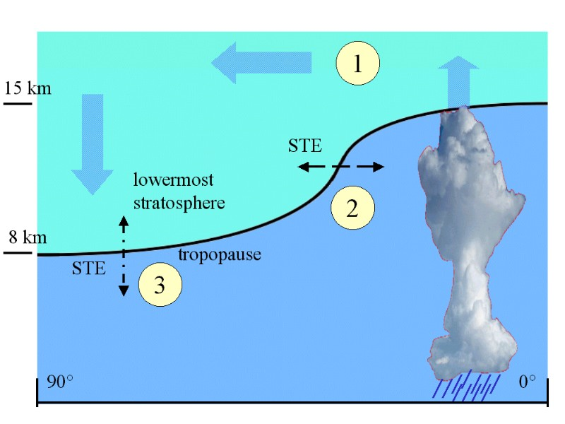
Strat-Trop Exchange

Slide 34
The Stratosphere
Region where much of ozone exists (20-40 km)
Heated by absorption of solar UV by O₃
Temperature increases with altitude
Temperature increase makes it very stable (stratified)
Timescale for vertical transport of gases can become very long (≈ years)

Slide 35
Basic Ozone Chemistry
Oxygen photodissociated by deep UV
O₂ + hν → O + O
O + O₂ → O₃
O₃ photolysis in near UV - leads to heating
O₃ hν → O + O₂
Chain termination
O + O₃ → O₂ + O₂

Slide 36
These reactions basically explain the presence of ozone, and the thermal structure of the stratosphere
Known as the Chapman mechanism
  Chapman (1930 or so)
However it does not explain the O₃ conc^{n} quantitatively
O₃ reduced by catalytic cycles

Slide 37
Catalytic Ozone Loss
In the presence of small traces of free radicals:
X + O₃ → XO + O₂
XO + O → X + O₂
Net: O + O₃ → O₂ + O₂
X + O₃ → XO + O₂
XO + O₃ → X + 2 O₂
Net: O₃ + O₃ → 3 O₂

Slide 38
What Causes Ozone Loss?
Hydrogen species
OH + O₃ → HO₂ + O₂
Followed by
HO₂ + O₃ → OH + 2 O₂ (lower altitude)
O + HO₂ → OH + O₂ (higher altitude)
Source:
O₃ + hν → O(¹D) + O2
O(¹D) + H₂O → 2 OH

Slide 39
Nitrogen Species
NO/NO₂
O(¹D) + N₂O → 2 NO
N₂O emitted at the surface, naturally present
However there was concern about direct emissions of NO from aircraft

Slide 40
Halogen Species
Cl/ClO
Halogens are naturally present in the troposphere
e.g. sea salt (NaCl) methyl chloride (CH₃Cl)
However, these do not reach the stratosphere

Slide 41
Rapid loss of ozone was observed over Antarctica in the 1970s – 1980s
Named the “Ozone Hole”
Correlated with growth of fluorocarbons (Freons)
Chlorine release followed by rapid O₃ loss
CF₂Cl₂ + hν → CF₂Cl + Cl
O(1D) + CF₂Cl₂ → ClO + CF₂Cl
Cl + O₃ → ClO + O₂
O + ClO → Cl + O₂

Slide 42
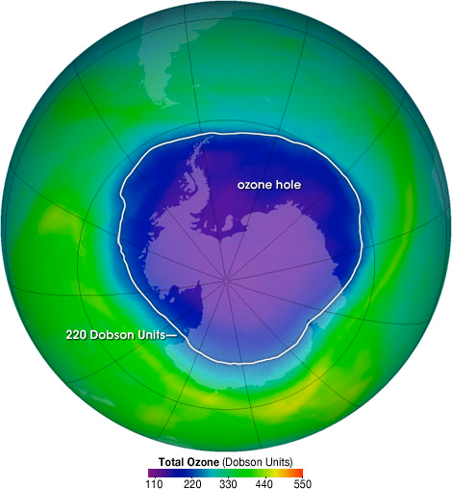
The ozone hole is the region over Antarctica with total ozone of 220 Dobson Units or lower. This map shows the ozone hole on October 4, 2004. The data were acquired by the Ozone Monitoring Instrument on NASA’s Aura satellite.

Slide 43
Role of “Ice” Clouds
Cl-catalysis stopped by formation of reservoirs
Cl + CH₄ → HCl + CH₃
ClO + NO₂ → ClONO₂
However, these were found to react together on Polar Stratospheric Clouds (PSC)
HCl + ClONO₂ → Cl₂ + HNO₃
PSCs composed of ice or ice/HNO₃

Slide 44
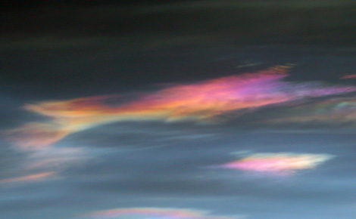
Courtesy NASA ozonewatch.gsfc.nasa.gov

Slide 45
Montreal Protocol
As a result of the research performed on ozone depletion, chlorofluorocarbons were banned.
Since then, other compounds have been added
Alternative compounds have been developed
  e.g. HFCs such as CF₃CH₂F
Ozone recovery thought to be underway?

Slide 47
Properties of the Atmosphere
Two major components: air and water
Liquid water present in clouds and aerosol
Water vapor also present in gas phase
Major reactant in atmosphere:
  O(1D) + H2O → 2 OH
Climate effects associated with both gas- and liquid-phase water

Slide 48
Compare properties
Densities differ by a factor of 800
H₂O (liq) 1 g cm⁻³
Air 1.3 mg cm⁻³
Water incompressible
Air is compressible (density changes with height)

Slide 49
Air is not a compound – it is a mixture of many chemicals. Nevertheless we can define an effective molecular weight
Nominal composition:
N₂ 78%, O₂ 21%, Ar 1%
  MW = 0.78*28 + 0.21 * 32 + 0.01*40 = 28.96
Other properties (specific heat, etc), defined in an analogous way.

Slide 50
Ideal Gas Law
For atmospheric temperatures and pressures, the atmosphere is an ideal gas.
PV = nRT
Where P is the local pressure, V the volume, T the temperature, n the number of mole(cule)s and R the gas constant
R = 8.314 J mol⁻¹ K⁻¹ = 1.98 cal mol⁻¹ K⁻¹
= 0.082 L-atm mol⁻¹ K⁻¹ = N_{a} * k(_{boltzmann})
It is vital to be comfortable switching units!

Slide 51
Variation of P with Height
Many simple properties can be derived from the Ideal Gas Law:
Density (ρ) = mass/unit volume = M_{eff} *(n/V)
= M_{eff} *(P/RT)
Consider an air parcel, of area A and thickness dz
Volume of parcel is Adz, mass is ρAdz

Slide 52
Gravitational force acting on the parcel is:
g* ρAdz
But, pressure is force per unit area,
So dP = -gρdz
From earlier, ρ = M_{eff}P/RT
dP = -(gM_{eff}P/RT)*dz
or, d(lnP) = -(gM_{eff}/RT) * dz

Slide 53


Scale Height
Integrating the previous equation:
Defining H = RT/(gM_{eff})
Where H is the Scale Height

Slide 54
H is the height by which the pressure falls to 36% of its value at the ground (1/e)
Value of H:
H = RT/(gM_{eff}) = (8.314*273)/(9.81/29e-3)
  = 7980 m, or about 8 km.
  In practice, the atmosphere is not isothermal,
  and H ≈ 7 km
  [equivalent to a factor of 10 for 16 km ≈ 10 miles]

Slide 55
Getting back to our original air parcel:
Mass of parcel = ρAdz
Since pressure and density are proportional
ρ(z) = ρ_{o}exp(-z/H)
Total mass of column of air = ∫ Aρ_{o}exp(-z/H)dz
= HAρ_{o}
So, the mass can be represented by a column height H and density ρ_{o}
Useful relationship! Contrast to liquid hAρ

Slide 56

Lapse Rate
The troposphere is not isothermal
Temperature drops with height
By considering work done on an ascending air parcel, can show that:
This is the Dry Lapse Rate, ≈10 K/km
In practice, air contains humidity → 7 K/km

Slide 57
If ∂T/∂z > 0, have a temperature inversion
Stable situation, typical when the ground is cold overnight
More generally, need to consider the Potential Temperature, Θ
Θ = T(P_{o}/P)^{R/Cp}
This is the temperature an air parcel would have if it were brought adiabatically to the surface.
Measure of vertical stability
Conserved when air parcel rises or falls

Slide 58
Pressure and Number Density
Using the ideal gas law, can find the number density at a given P and T
PV = nRT, so n/V = P/RT
At the surface, P_{o} = 1 bar = 101325 N m⁻²
n/V = 2.69 x 10¹⁹ molecule cm⁻³ at 273 K
= 2.45 x 10¹⁹ molecule cm⁻³ at 298 K
The number density of other species are proportional to their partial pressures

Slide 59
Mixing Ratio
This is the number density of a given component relative to that of the total
Equivalent to a partial pressure
χ(A) = n(A)/n(air)
  NB: 1 ppm = 1 in 10⁶ ; 1 ppb = 1 in 10⁹
Useful if considering transport, because it is conserved
If considering reaction rates, need to use n because it is absolute

Slide 60
Concentrations as a f^{n} of z
Pressure (and number density) fall off exponentially with height. Assume CO₂ is well mixed at 370 ppm
z n(air) n(O₂) n(CO₂)
0 2.7E19 5.6E18 9.9E15
7 9.9E18 2.1E18 3.7E15
15 3.1E18 6.6E17 1.2E15
30 3.7E17 7.8E16 1.4E14

Slide 61
Water in the Atmosphere
Not all gases are well-mixed
Water is a strong function of temperature
Near surface, typically 1E17-8E17 molec cm⁻³
(RH 20-80%)
At tropopause, 4ppm ~ 1.6E13 molec cm⁻³

Slide 62
Liquid Water
Have to consider both mass of water, and also size distribution
In a cloud, typically have 10⁻⁶ g H₂O cm⁻³
Aerosol much lower ~10⁻¹⁰ or so
Concentrations in liquid expressed in mol/L

Slide 63
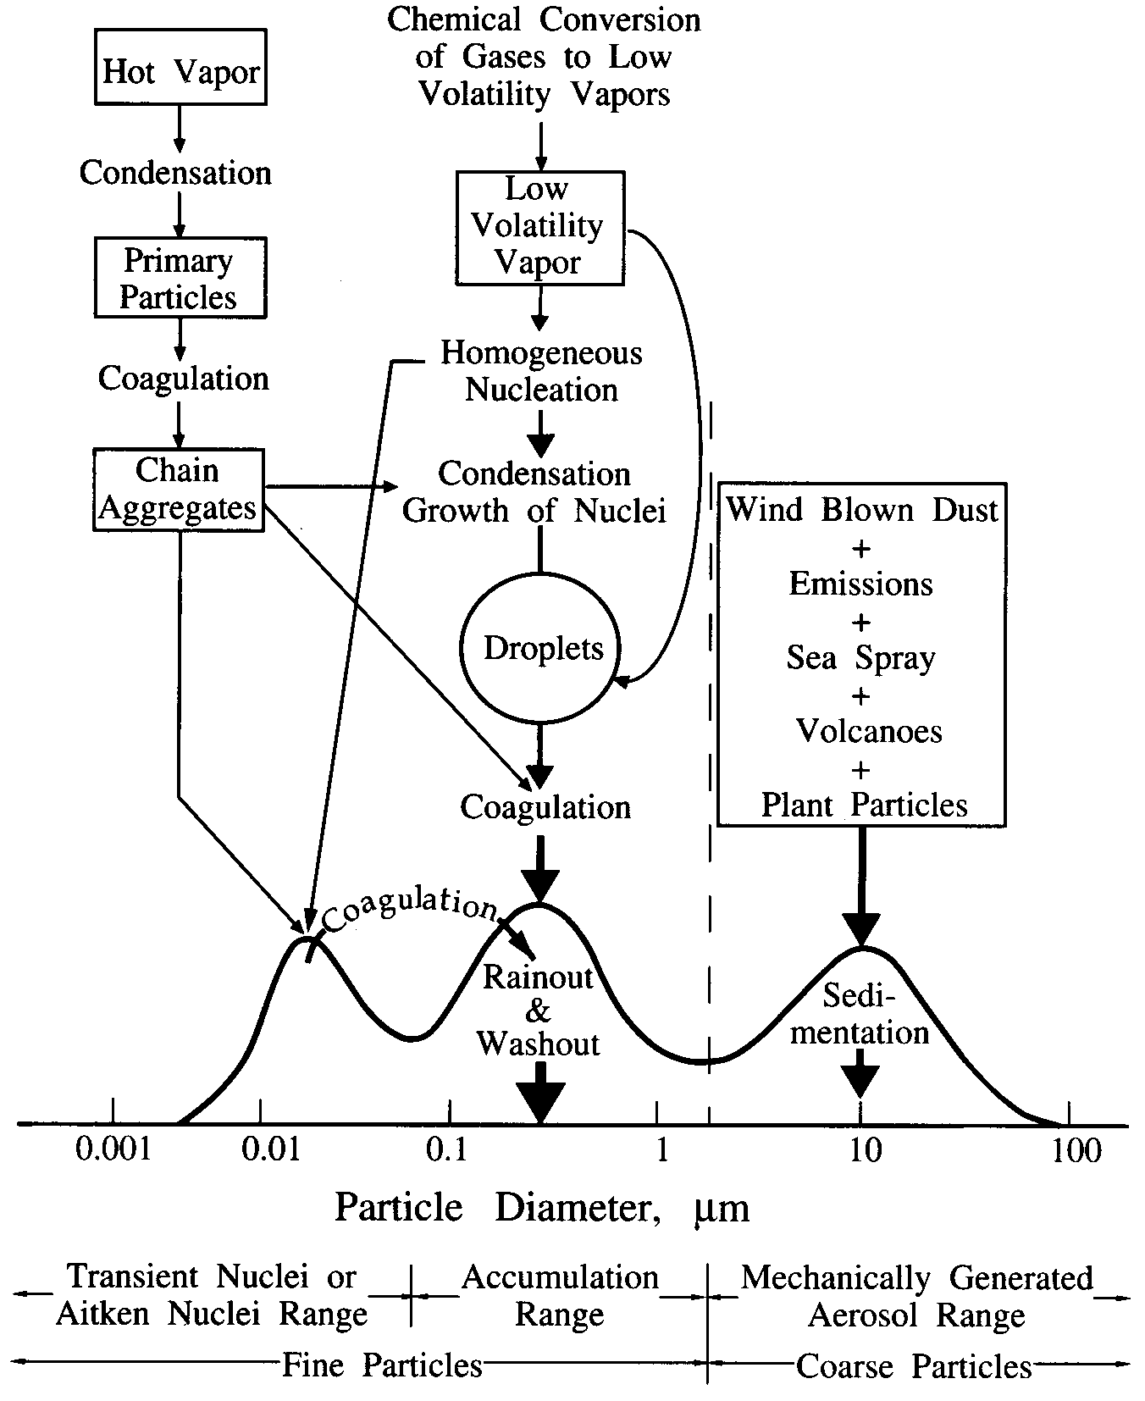
Aerosol size distributions
Seinfeld &Pandis
After
Whitby & Cantrell

